Slide 1
Time Series Analysis
International Airline Travels

Slide 2
Available Data is of International Airline travel time
We plot the data to see its stationarity and found that
Both Mean and variance of data are on increasing trend,
Hence data is not stationary,
To make it Stationary we transpose the data in to log &
Square root but the results were not satisfying.

Slide 3
Since for ARIMA forecasting the data must be
Stationary. After Differencing the log of AIR , Data became stationary
to carry out further analysis.
Also Since, p-value is <0.001, we reject HO and conclude DIF_LOG_AIR is stationary
Here mean & Variance both are constant.

Slide 4
Rho Statistics
Tao Statistics
Further to Ensure the stationarity of data we use ADF test
And check Rho & Tao Statistics the p values of
must be <0.001
Here since p-value<0.001,
we reject HO and conclude DIF_LOG_AIR is stationary
P-LogAir | P SQRT Air | P Diff_Log_Air | P Diff_SQRT_AIR |  | P-LogAir | P SQRT Air | P Diff_Log_Air | P Diff_SQRT_AIR
0.7312 | 0.7697 | 0.0001 | 0.0001 |  | 0.903 | 0.8347 | 0.0001 | <.0001
0.7266 | 0.7349 | 0.0001 | 0.0001 |  | 0.8602 | 0.761 | 0.0001 | <.0001
0.7263 | 0.7615 | 0.0001 | 0.0001 |  | 0.8834 | 0.814 | 0.0001 | <.0001
0.4082 | 0.4069 | 0.0001 | 0.0001 |  | 0.3714 | 0.4202 | 0.0001 | <.0001
0.2474 | 0.1794 | 0.0001 | 0.0001 |  | 0.2784 | 0.2431 | 0.0001 | <.0001
0.4095 | 0.3435 | 0.0001 | 0.0001 |  | 0.4545 | 0.4331 | 0.0001 | <.0001
0.0005 | 0.0005 | 0.0001 | 0.0001 |  | 0.0006 | 0.0006 | 0.0001 | <.0001
0.0001 | 0.0001 | 0.0001 | 0.0001 |  | <.0001 | <.0001 | 0.0001 | <.0001
0.0001 | 0.0001 | 0.0001 | 0.0001 |  | <.0001 | <.0001 | 0.0001 | <.0001

Slide 5
To conduct the time series analysis it is also necessary
To Remove the seasonality of the data which act as
correlation between the time points.
found seasonality in every 12 months
Which is needed to be removed.
After removing the seasonality we got the data
Structure something like this bar graph, with
No signs of seasonality.

Slide 6
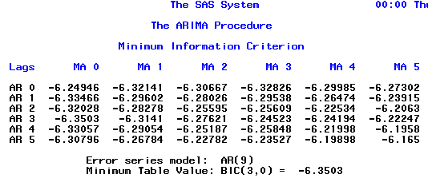
We divide the data in to validation and
development models Where the data
with date < 1960 is in to validation and
the data with date> 1960 is in development
model
This is done to test our final model on
development data
here after we get the combination of P & Q
by Proc AIMA MINIC , to get the order of AR and MA
Since the minimum table value BIC is at (3,0) we
need to do the iterations of the combinations from 0,1 to 3,3 to get the model with 6-7 lowest averages of AIC , BIC so that we can get the model with lowest MAPE
AR | MA | AIC | SBC | AVG
2 | 3 | -423.067 | -406.392 | -414.73
3 | 3 | -424.162 | -404.708 | -414.435
0 | 1 | -410.072 | -404.514 | -407.293
1 | 0 | -409.809 | -404.25 | -407.03
0 | 3 | -410.936 | -399.82 | -405.378
3 | 0 | -410.65 | -399.54 | -405.095
0 | 2 | -408.119 | -399.782 | -403.951
3 | 2 | -412.227 | -395.552 | -403.89
1 | 1 | -407.99 | -399.65 | -403.82
2 | 0 | -407.816 | -399.479 | -403.648
1 | 3 | -409.172 | -395.276 | -402.224
2 | 1 | -407.355 | -396.238 | -401.797
1 | 2 | -407.191 | -396.074 | -401.633
2 | 2 | -407.445 | -393.549 | -400.497
3 | 1 | -406.693 | -392.797 | -399.745

Slide 7
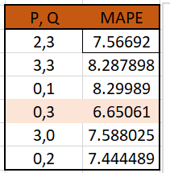
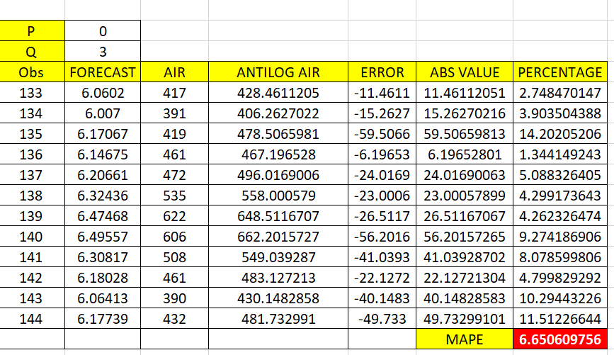
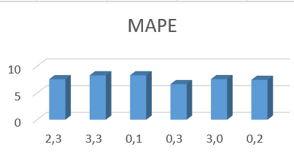
Model With Lowest MAPE (Mean Percentage Abs Error)

Slide 8
Since we have calculated our model with a transformed variable
diff12_diff_log_air , we need to make our model on normal air data with minimum Transformations
So we add differencing seasonality in log Air IDENTIFY VAR = LOG_AIR(1,12);
With estimates taken as 0,3(with lowest MAPE) and lead value of 12 (number of predictions to be made)
Here we can see the values are syncing together nicely proving our model fit and sound

Slide 9
Thank You

